Slide 1
SUPPORT TICKETING SYSTEM
Vineeth. D 21f1004514
Sharan. S 21f2000620
Dheeraj. M 21f1004378

Slide 2
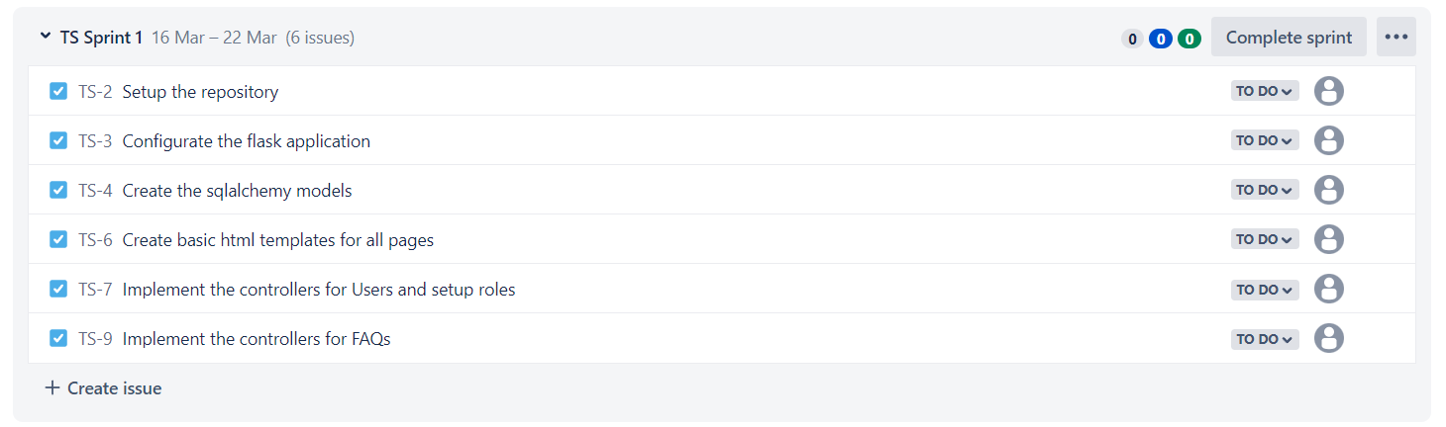
Schedule
The overall development will be split into multiple sprints. The tasks planned for the sprints are as follows.

Slide 3
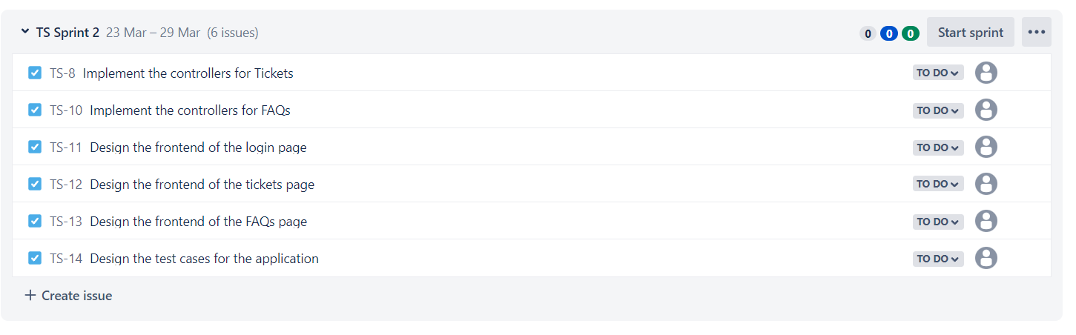
Schedule

Slide 4
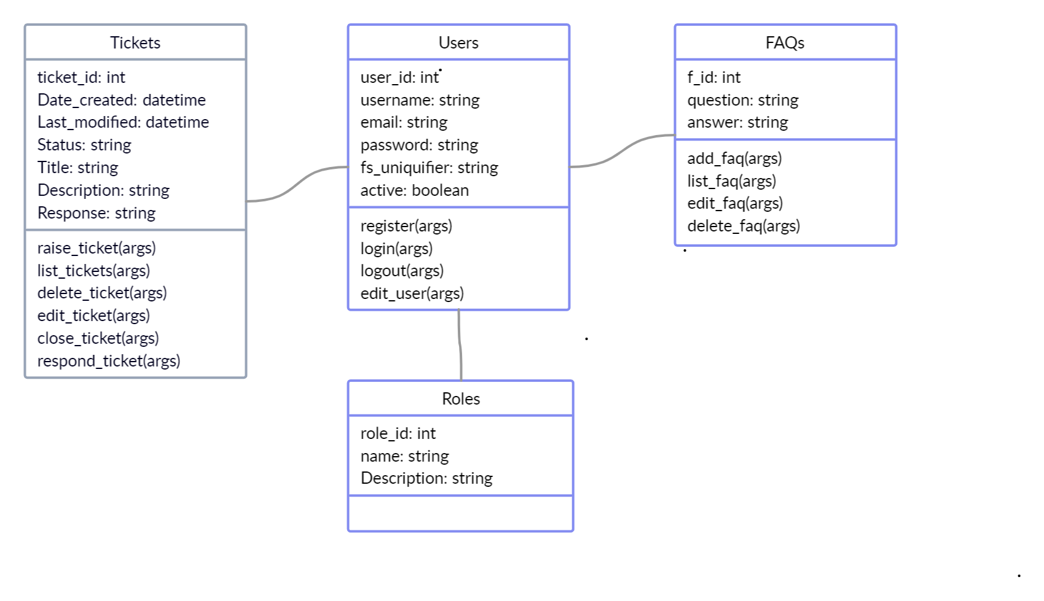
Class diagram
The class diagram for the application is shown below. The different roles present in the application will determine the required access for the members.

